Slide 1
Separation Techniques-I
ANALYTICAL CHEMISTRY
Presented By :
K.N.S.SWAMI., M. Sc., SET
Guest Faculty in Chemistry
P. R. Government College (Autonomous), Kakinada.

Slide 2
CONTENTS
INTRODUCTION
SUBLIMATION
CRYSTALISATION
FILTRATION
DECANTATION
EVAPORATION
CENTRIFUGATION
DISTILLATION
SIMPLE DISTILLATION
FRACTIONAL DISTILLATION
SIMPLE DISTILLATION VS FRACTIONAL DISTILLATION

Slide 3
Introduction:
Separation techniques are those techniques that can be used to separate two different states of matter such as liquids and solids.
Separation techniques are classified based on type of mixtures:
Separation techniques
For solid in liquid mixtures
For liquid in liquid mixtures
Heterogenous:
Sedimentation / gravitation
Filtration
Magnetic separation
Fractional distillation
Homogenous:
Evaporation
Distillation
centrifugation
Homogenous:
Simple or fractional distillation.
Chromatography
Heterogenous:
1. Partition separation
using funnel

Slide 4
METHODS OF PURIFICATION OF ORGANIC COMPOUNDS
Once an organic compound is extracted from a natural source or synthesized in the laboratory, it is essential to purify it. Various methods used for the purification of organic compounds are based on the nature of the compound and the impurity present in it.
The common techniques used for purification are as follows :
Methods of Purification
Sublimation
Solids
Crystallization
Distillation
Differential Extraction
Liquids
Chromatography

Slide 5
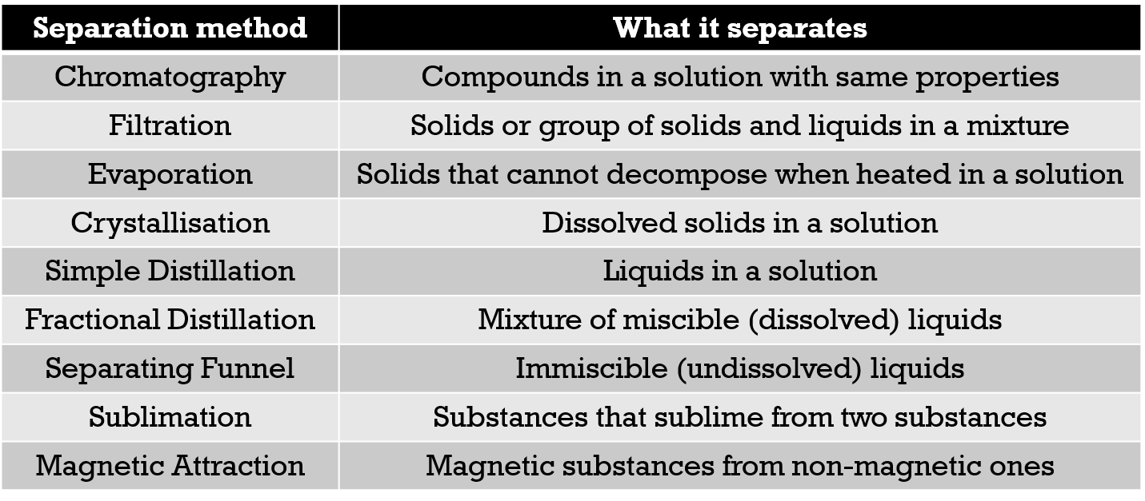
Separation Methods

Slide 6
Difference in Properties enable the Separation Methods to Work
Separation method | Differences between objects
Chromatography | Solubility with ethanol
Filtration | Size of particles
Evaporation | State of object (solid and liquid)
Crystallisation | State of object (solid and liquid)
Simple Distillation | Boiling points
Fractional Distillation | Boiling points
Separating Funnel | Both are immiscible
Sublimation | Ability to sublime
Magnetic Attraction | Magnetism

Slide 7
Sublimation
&
Crystallization

Slide 8
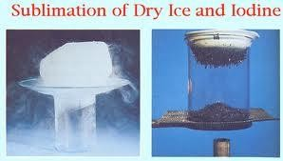
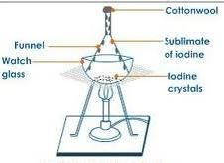
Sublimation
Change from solid to vapour.
Without passing through
liquid state
The process of conservation of a solid directly into its vapour is called sublimation
Use :
Used to separate volatile organic compounds from non volatile impurities e.g. Naphthalene, benzoic acid, anthracene, camphor.
To separate sublimable compound from non–sublimable impurities

Slide 9
Many organic compounds directly form vapours, when solid compounds are heated, without becoming a liquid at any stage. On cooling the vapours the solid is directly obtained.
Procedure:
Place the mixture in an evaporating dish. Position the dish under a bunsen burner.
Place an inverted funnel just above the dish.
The substance with high melting point would be left on the dish.
The other substance will vapourise and solidify when it lands on the surface of the funnel.

Slide 10
Crystallization
CRYSTALLIZATION
Obtaining solid in pure and crystalline form from its solution.
Principle :
Substance is more soluble in a given solvent at higher temperature than at lower temperature .
Crystallization is one of the oldest purification techniques applied for solid organic compounds. It has these stages of a continuous process summarized below:
Dissolution
Hot filtration
Crystallization
Filtration of crystal
Drying of crystal

Slide 11
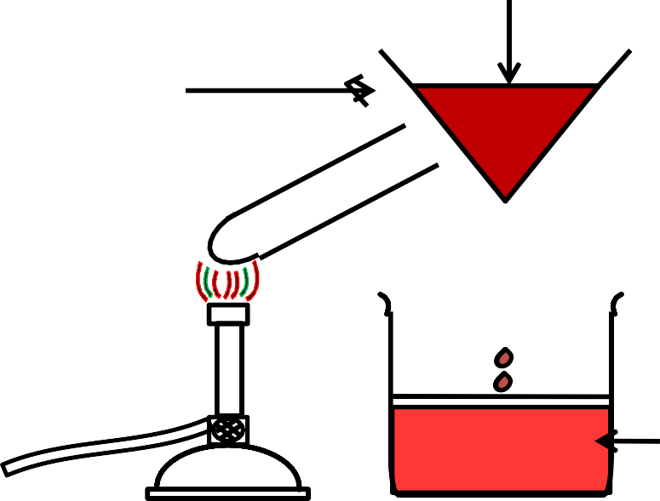
Solution
It is based on the difference in the solubilities of the compound and the impurities in a suitable solvent. The impure compound is dissolved in the solvent in which it is sparingly soluble at room temperature but appreciably soluble at higher temperature.
The solution is concentrated to get a nearly saturated solution , on cooling the solution pure compound crystallizes out and is removed by the filtration.
The filtrate contains impurities and small quantity of the compound.
If the compound is highly soluble in one solvent and very little soluble in another solvent , Crystallization can be carried out.
Impurities which impart color to the solution are removed by adsorbing over activated charcoal.
Glass funnel
Insoluble impurities
Hot water
Jacket
Filtrate

Slide 12
FRACTIONAL CRYSTALLIZATION
Separating components of mixture of two or more solids, having different solubilities in the same solvent at the same temperature, by step wise crystallization
Least soluble substance crystallizes out first (separated.)
Recrystallization.
More soluble substance crystallizes out.

Slide 13
Recrystallisation
Recrystallisation: It is a method used to purify an organic solid.
A small amount of the solvent is added to a flask containing an impure solid. The contents of the flask are heated until the solid dissolves. Then the solution is cooled. A more pure solid separates out, leaving impurities dissolved in the solvent.
Example for recrystallisation:
1.0 g of crude benzoic acid is taken in a 50 ml flask. Add a little water and boil
Some contaminants will not dissolve Transfer to a conical flask and cool
Filter the crystals and allow to dry for 5-10 mins
Impure benzoic acid
Benzoic acid after recrystallisation

Slide 14
Filtration
&
Decantation

Slide 15
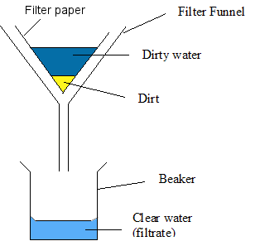
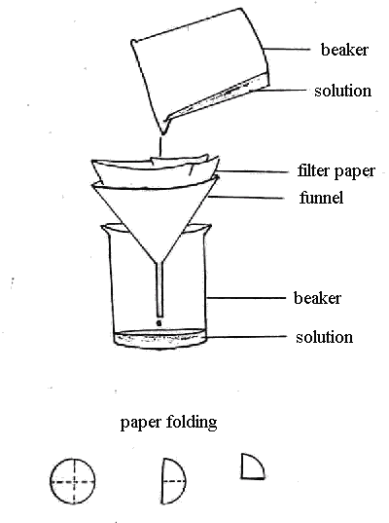
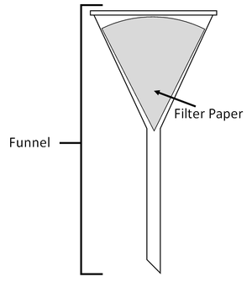
Filtration
Filtration is one of the most applied processes in organic and pharmaceutical chemistry practices.
In general, filtration is categorized into two groups;
Gravity filtration
Vacuum filtration
Place a piece of filter paper in a filter funnel. Position a beaker under the filter funnel.
Pour the mixture into the filter funnel. The liquid passes through the filter paper while the insoluble solids does not pass through.
The filtrate will be collected in the beaker and the residue remains on the filter paper.
Wash the residue with distilled water and let it dry. Separation is complete.

Slide 16
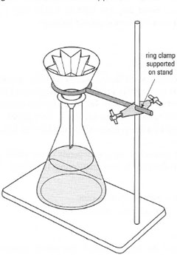
Gravity Filtration Method
Gravity filtration is the simple form of filtration.
Requirement: Funnel, Filtration paper and a Erlenmeyer..

Slide 17
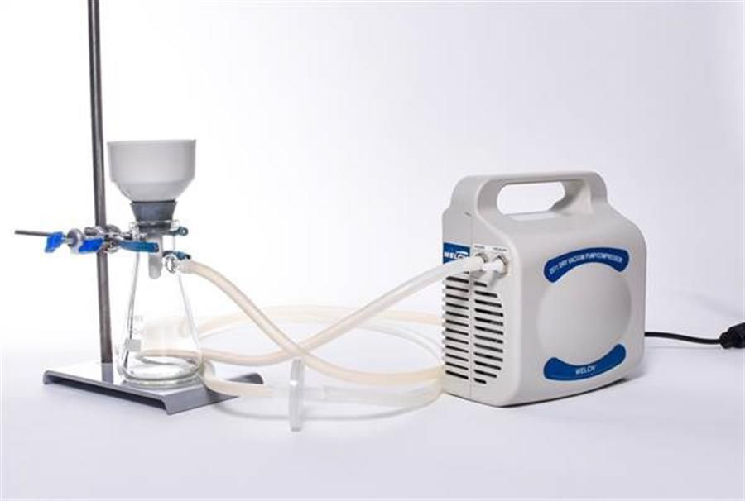
Vacuum Filtration
Vacuum filtration is much faster than gravity filtration. The only difference is the employing of vacuum as a deriving force for filtration.

Slide 18
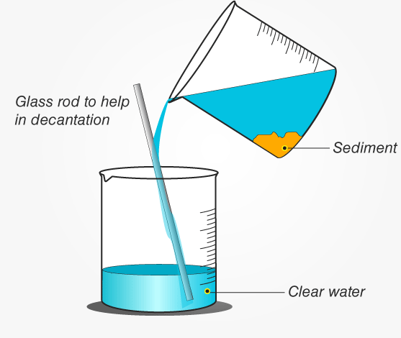
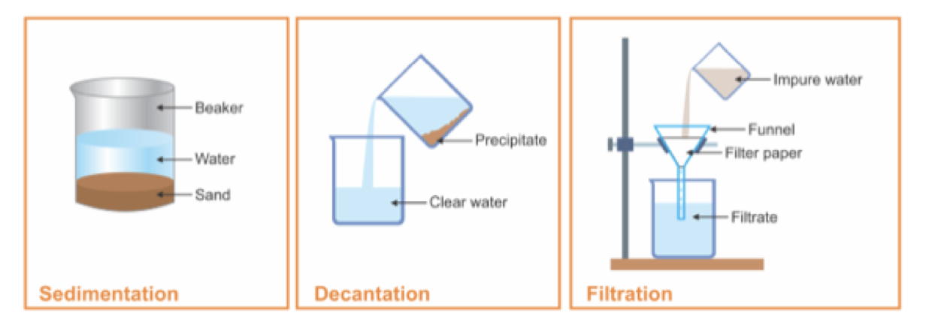
Decantation:
Decantation is a process to separate mixtures by removing a liquid layer that is free of a precipitate. The purpose may be to obtain a decant (liquid free from particulates) or to recover the precipitate.
A piece of glassware called a decanter is used to perform decantation.
Decantation is a method for separating a mixture of a liquid and a heavier solid. In this process, first the sold impurities are allowed to sediment at the bottom of the container.
• Then, the pure liquid is poured out carefully from the container into another container. The precipitate or solid is left behind at bottom of the container.
• The pouring off of a liquid from settled solid separates liquid from undissolved solid.

Slide 19
EVAPORATION
&
CENTRIFUGATION

Slide 20
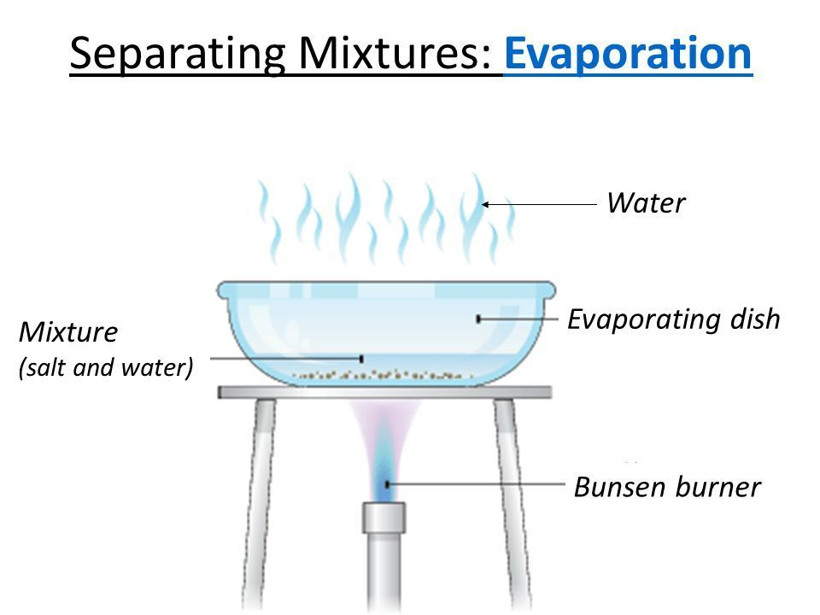
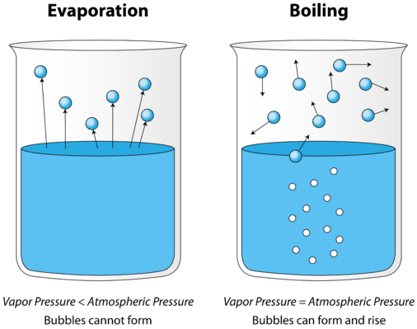
Evaporation
Evaporation is a physical separation process, which removes a volatile component from a liquid solution or mixture by vaporization, obtaining a concentrated product of the nonvolatile components.
Evaporation is a type of phase transition; it is the process by which molecules in a liquid state (e.g water) spontaneously become gaseous (e.g water vapor). The equipment used for evaporation is known as Evaporator.
APPLICATION OF EVAPORATION
MANUFACTURING OF BULK DRUGS
MANUFACTURING OF BIOLOGICAL PRODUCTS
MANUFACTURING OF FOOD PRODUCTS
MANUFACTURING OF DE MINERALISED WATER

Slide 21
FACTORS EFFECTING EVAPORATION:
1. Temperature: -
Higher the temperature greater will be the evaporation.
2. Vapor pressure: -
Rate of evaporation is directly proportional to the vapor pressure of the liquid. - Lower the pressure ,greater will be the evaporation.
3. Surface area: -
Greater the surface area of the liquid, greater will be the evaporation.
4. Time of evaporation: -
Exposure time is longer, more will be the evaporation.
5. Density: -
The higher the density, slower the liquid evaporates.
6. Concentration: -
Low concentration of the substance, faster the evaporation.

Slide 22
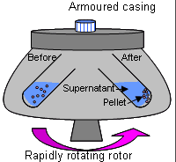
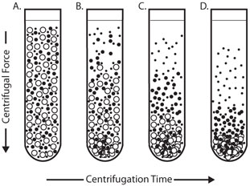
CENTRIFUGATION
WHAT IS CENTRIFUGE?
Centrifuge is a device for separating particles from a solution according to there size, shape, density, viscosity of the medium.
WHAT IS CENTRIFUGATION?
Centrifugation is a process which involves the use of the centrifugal force for the sedimentation of heterogeneous mixtures with a centrifuge.
Centrifugation is a procedure that involves the use of centrifugal force for the sedimentation of mixture with a centrifuge used in industry and in laboratory settings. More dense components of the mixture move away from the axis of the centrifuge while less dense components of the mixture move towards the axis

Slide 23
A particle whether it is a precipitate a macromolecule or a cell organelle is subjected to a centrifugal force when it is rotated at a high rate of speed. The centrifugal force F is denoted by equation
F=mω2 r
Where F= intensity of the centrifugal force
m= effective mass of the sedimenting particle
ω= angular velocity of rotation
r= distance of the migrating particles from the central axis of rotation
A more common measurement of F in terms of the earths gravitation force , g, is Relative Centrifugal Force (RCF), RCF its defined by
RCF = (1.119 x 10-5 (rpm)2 (r)
This equation relates RCF to revolutions per minute of the sample . Equation dictates that the RCF on a sample will vary with r, the distance of the sedimenting particles from the axis of rotation . The RCF value is reported as “ a number times gravity ,g .”

Slide 24
Applications
In clinical laboratory, centrifugation is used to;
Remove cellular elements from blood to provide cell free plasma or serum for analysis.
Remove chemically precipitated protein from an analytical specimen.
Separate protein bound from free ligand in immunochemical and other assay.
Separation of the subcellular organelle, DNA, RNA.
Extract solutes in biological fluids from aqueous to organic solvents.
Separate lipid components.
Velocity Sedimentation Centrifugation:
Centrifuges are used most often For Preparative-Scale Separation procedures .
this technique consist of
Placing the sample in a tube or similar container
Inserting the tube in the rotor
Spinning the sample for a fixed period .
The sample is removed and the two phases ( Pellet and supernatant ) may be separated by careful decantation

Slide 25
It separate particles ranging in size :
From Coarse precipitates to cellular organelles .
Heavy precipitates are sediment in Low-Speed Centrifuges .
Lighter Organelles such as ribosomes require the High centrifugal forces of an ultracentrifuge

Slide 26
Fractional Centrifugation :
This specific method of separation consists of successive centrifugation at increasing rotor speeds .
the rotor chamber must be kept at low temperature to maintain the native structure and function of each cellular organelle ant its component biomolecules .
The Operation :-
A high-speed centrifuge equipped with a fixed angle rotor is the most appropriate for the first two centrifugations at 600 xg and 20,000 xg .
After each centrifuge run , the supernatant is poured into another centrifuge tube , which is then rotated at the next higher speed .
The final centrifugation at 100,000 xg to
sediment microsomes and ribosomes must be done in an ultracentrifuge .

Slide 27
DISTILLATION

Slide 28
DISTILLATION
Liquid is converted into its vapour phase at its boiling point and vapour is then condensed back to liquid on cooling is known as DISTILLATION.
Distillation is the process of separating the components or substances from a liquid mixture by using selective boiling and condensation.
Organic compounds in the liquid state are purified by distillation.
Distillation involves the heating of a liquid to boiling and then collecting their vapours to condense them in liquid state.
Principle :
It involves both evaporation of a liquid and condensation of its vapour.

Slide 29
This important method is used to separate:-
(i) Volatile liquids from nonvolatile impurities
(ii) And the liquids having sufficient difference in their boiling points.
Liquids having different boiling points vaporize at different temperatures. The vapours are cooled and the liquids so formed are collected separately.
The liquid mixture is taken in a round bottom flask and heated carefully. On boiling, the vapours of lower boiling component are formed first. The vapours are condensed by using a condenser and the liquid is collected in a receiver. The vapours of higher boiling component form later and the liquid can be collected separately.
Distillation can be classified into four main types 1. Simple distillation
i. Under atmospheric pressure
ii. Under reduced pressure
2. Fractional distillation
3. Steam distillation
4. Destructive distillation

Slide 30
Simple Distillation
Simple distillation is designed to evaporate a volatile liquid from a solution of non-volatile substances; the vapor is then condensed in the water condenser and collected in the receiver.
Principle:
Liquid boils when its vapour pressure is equal to atmospheric pressure. Simple distillation is conducted at its boiling point.
The higher the relative volatility of a liquid, the better is the separation by simple distillation. Heat is supplied to the liquid so that it boils. The resulting vapour is transferred to a different place and condensed.
WORKING PROCESS:
The liquid to be distilled is filled into the flask to one-half to two-third of its volume. Bumping is avoided by adding small pieces of porcelain before distillation.
A thermometer is inserted into the cork and fixed to the flask. The thermometer bulb must be just below the level of the side arm.
Water is circulated through the jacket of the condenser. The contents are heated gradually.
The liquid begins to boil after some time. The vapour begins to rise up and passes down the side arm into the condenser.
The temperature rises rapidly and reaches a constant value.
The temperature of the distillate is noted down, which is equal to the boiling point of the liquid. The vapour is condensed and collected into the receiver.
The flame is adjusted so that the distillate is collected at the rate of one to two drops per second. Distillation should be continued until a small volume of liquid remains in the flask.

Slide 31
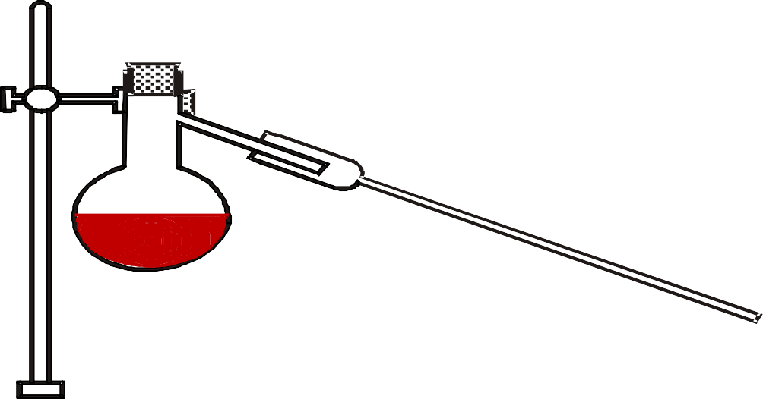
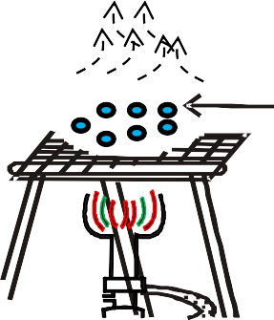
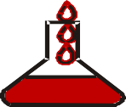
SIMPLE DISTILLATION
Stand
Thermometer
Distillation flask
Delivery
tube
Leibig water condenser
Porcelain pieces
Impure
liquid
Wire gauze
Tripod
stand
Pure liquid
Receiver

Slide 32
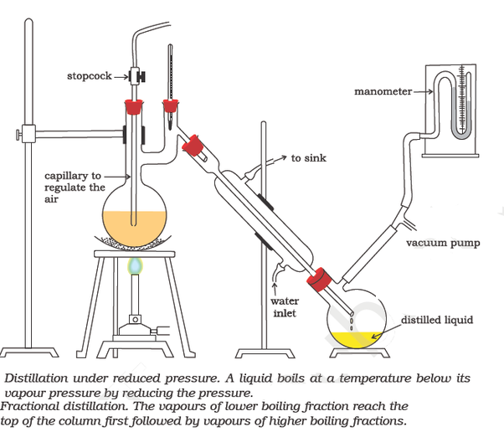
Applications:
For the preparation of distilled water and water for injection.
Volatile and aromatic waters are prepared.
Organic solvents are purified.
A few official compounds are prepared by distillation. Examples are spirit of nitrous ether and aromatic spirit of ammonia.
Non-volatile solids are separated from volatile liquids.
Simple Distillation under reduced pressure (Vacuum Distillation)
This method is used to purify liquids having very high boiling points and those, which decompose at or below their boiling points. Such liquids are made to boil at a temperature lower than their normal boiling points by reducing the pressure on their surface. A liquid boils at a temperature at which its vapour pressure is equal to the external pressure. The pressure is reduced with the help of a water pump or vacuum pump Glycerol can be separated from spent-lye in soap industry by using this technique.

Slide 33
Principle:
Applicable to the purification of liquids that have high boiling points
and decompose at or below their boiling points.
Principle :
By lowering the external pressure b.p of the liquid can be decreased.
Example :
H₂O₂ normal b.p at 760 mm pressure is 152⁰C, but by decreasing external pressure to 65 mm, it boils at 85⁰C.
• Liquid boils when vapour pressure is equal to the atmospheric pressure, i.e., pressure on its surface. If the external pressure is reduced by applying vacuum, the boiling point of liquid is lowered.
• Therefore, the liquid boils at a lower temperature. This principle is illustrated using an example of water.
• Water boils at an 100°C at an atmospheric pressure is 101.3I kPa (760 mm Hg). At 40°C, the vapour pressure of water is approximately 9.33 kPa (70 mm Hg). Hence, the external pressure is reduced to 9.33 kPa (70 mm Hg) where water boils at 40°C. The net result is the increase in rate of mass transfer into vapour.

Slide 34
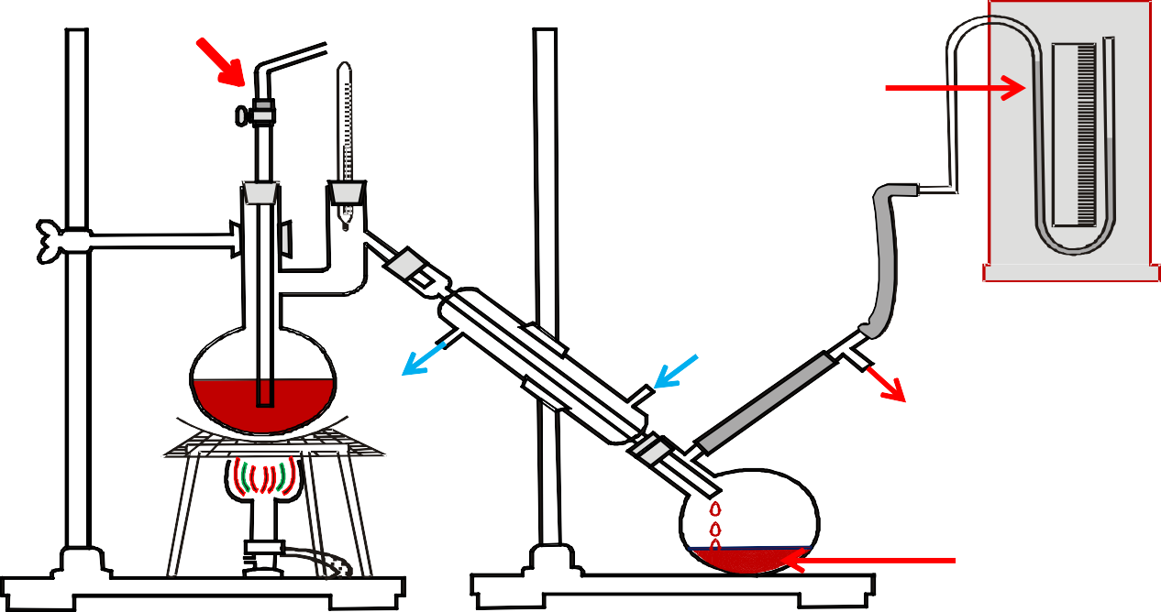
DISTILLATION UNDER REDUCED PRESSURE
Stopcock
Manometer
Water inlet
To sink
Vacuum
pump
Distilled liquid
The important factor in evaporation is:
Vapour Pressure of Evaporating Liquid
Mass of Vapour Formed α
External Pressure
According to this formula, water is allowed to evaporate at 40°C and 9.33 kPa (70 mm Hg) pressure, the mass of vapour formed in unit time is approximately 11 times, i.e. 760/70 for water.

Slide 35
Fractional Distillation
“Separating and purifying the components of a mixture of two or more miscible liquids having different boiling points.”
If the boiling point of the liquids in the mixture are very close to each other then such mixtures can be purified by fractional distillation. The difference in boiling points of the mixture is usually less than 40ºC.
e.g. – acetone(b.p. 56ºC)and methyl alcohol(b.p. 65ºC).
For fractional distillation, a suitable fractionating column is placed between the flask and the condenser.

Slide 36
Principle :
More volatile liquid distills out first leaving behind the less Volatile liquid.
When a liquid mixture is distilled, the partial condensation of the vapour is allowed to occur in a fractionating column.
In the column, ascending vapour from the still is allowed to come in contact with the condensing vapour returning to the still.
This results is enrichment of the vapour with the more volatile component.
By condensing the vapour and reheating the liquid repeatedly, equilibrium between liquid and vapour is set up at each stage, which ultimately results in the separation of a more volatile component.
Applications:
Fractional distillation is used for the separation of volatile miscible liquids with near boiling point such as
•Acetone and water
•Chloroform and benzene
Disadvantage:
Fractional distillation cannot be used to separate miscible liquids, which form PURE azeotropic mixtures.

Slide 37
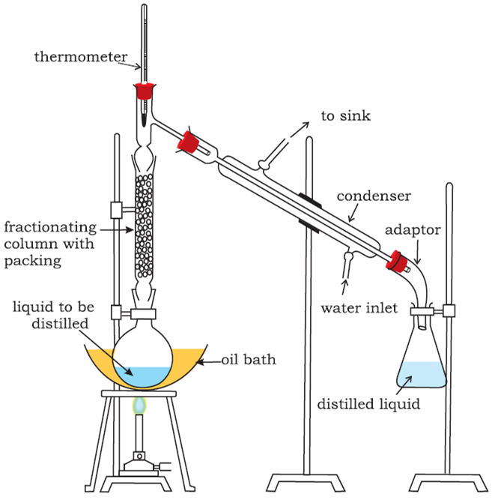
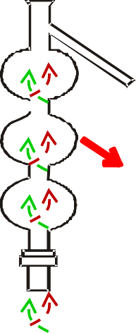
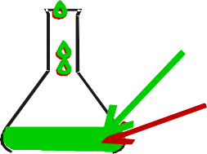
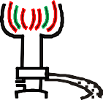
Fractional Distillation
Thermometer
Leibig water
condenser
Fractionating
column
Mixture of acetone & benzene
Benzene Acetone
Receiver

Slide 38
If the difference in boiling points of two liquids is not much, simple distillation cannot be used to separate them. The vapours of such liquids are formed within the same temperature range and are condensed simultaneously. The technique of fractional distillation is used in such cases. In this technique, vapours of a liquid mixture are passed through a fractionating column before condensation. The fractionating column is fitted over the mouth of the round bottom flask
Vapours of the liquid with higher boiling point condense before the vapours of the liquid with lower boiling point. The vapours rising up in the fractionating column become richer in more volatile component. By the time the vapours reach to the top of the fractionating column, these are rich in the more volatile component. A fractionating column provides many surfaces for heat exchange between the ascending vapours and the descending condensed liquid.
Some of the condensing liquid in the fractionating column obtains heat from the ascending vapours and re-vaporises. The vapours thus become richer in low boiling component. The vapours of low boiling component ascend to the top of the column. On reaching the top, the vapours become pure in low boiling component and pass through the condenser and the pure liquid is collected in a receiver.
After a series of successive distillations, the remaining liquid in the distillation flask gets enriched in high boiling component. Each successive condensation and vaporisation unit in the fractionating column is called a theoretical plate. Commercially, columns with hundreds of plates are available

Slide 39
Fractionating columns
In fractional distillation, special type of still-heads are required so that condensation and re-vaporisation are affected continuously.
These are known as fractionating columns.
A fractionating column is essentially a long vertical tube in which the vapour passes upward and partially condensed. The condensate flows down the column and is returned eventually to the flask.
The columns are constructed so as to offer the following advantages simultaneously.
(1) It offers a large cooling surface for the vapour to condense.
(2) An obstruction to the ascending vapour allows easy condensation.
Fractionating columns Types
Packed columns and
Plate columns
68

Slide 40
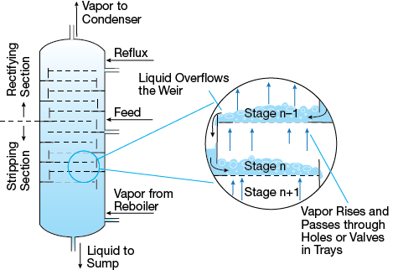
Packed columns
Some form of packing is used in the column to affect the necessary liquid/vapour contact. The packing may consist of single turn helices (spirals) of wire or glass, glass rings, cylindrical glass beads, stainless steel rings etc.
Construction: Packed column consists of a tower containing a packing that becomes wetted with a film of liquid, which is brought into contact with the vapour in the intervening spaces.
A long fractionating column is necessary when the boiling points of the constituents are lying fairly close together.
A short fractionating column is necessary when the boiling
point of the constituents differ considerably.
Applications:
Packing must be uniform so as to obtain proper channels. If packing is irregular, mass transfer becomes less effective.

Slide 41
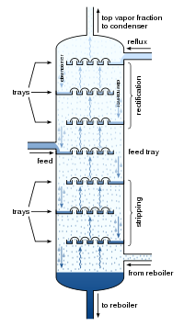
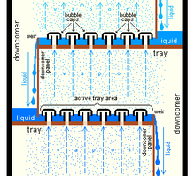
Plate columns
The distillation column is made up of a series of stacked plates. A liquid feed containing the mixture of two or more liquids enters the column at one or more points. The liquid flows over the plates, and vapor bubbles up through the liquid via holes in the plates.
Many forms of plates are used in the distillation using different columns. It can be divided into two types, which are commonly used in pharmacy.
Bubble cap plates
Turbo grid plates
Bubble cap column is used in large distillation plants .

Slide 42
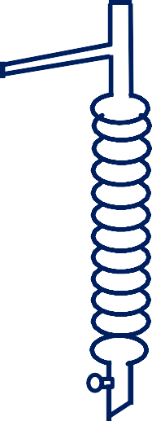
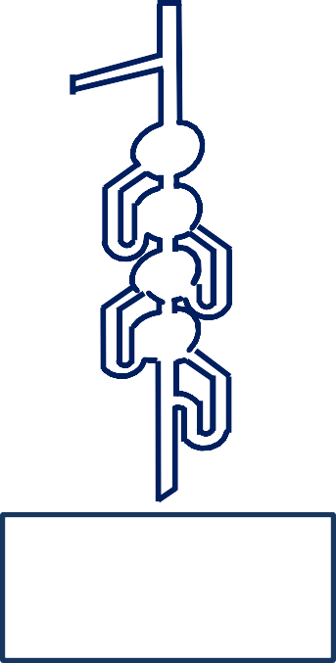
FRACTIONATING COLUMNS
Younger’s pear
shaped column
Hemple’s
column
Simple packed column
Bubble plate column

Slide 43
Simple Distillation Vs Fractional Distillation
In simple distillation, vapour is directly passed through the condenser.
In fractional distillation the vapour
must pass through a fractionating column in which partial condensation of vapour is allowed to occur.
Condensation takes place in the fractionating column, so that a part of the condensing vapour returns to the still.
Condensate is collected directly into the receiver,

Slide 44
THANK YOU

